Slide 1
Neural network tutorial: The back-propagation algorithm
https://www.youtube.com/watch?v=aVId8KMsdUU
By Ryan Harris

Slide 2
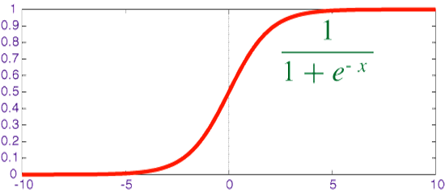

The neuron
The sigmoid equation is what is typically used as a transfer function between neurons. It is similar to the step function, but is continuous and differentiable.
Sigmoid Function
→ One useful property of this transfer function is the simplicity of computing it’s derivative.
Let’s do that now ……
$$σ(x)=\frac{1}{(1+e^{−x})}$$

Slide 3
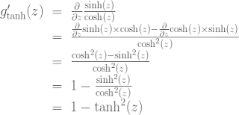







The derivative of the sigmoid transfer function
$$σ(x)=\frac{1}{(1+e^{−x})}$$
$$\frac{∂σ}{∂x}=\frac{∂}{∂x}(\frac{1}{1+e^{−x }})$$
$$= \frac{e^{−x }}{{(1+e^{−x })}^{2}}$$
$$= \frac{\left(1+ e^{−x }\right)−1 }{{(1+e^{−x })}^{2}}$$
$$= \frac{\left(1+ e^{−x }\right) }{{(1+e^{−x })}^{2}}+\frac{−1 }{{(1+e^{−x })}^{2}}$$
$$= σ\left(x\right) − {σ\left(x\right)}^{2}$$
$$σ^{′}= σ(1−σ)$$

Slide 4


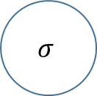



Single input neuron
$$θ$$
$$ω$$
$$σ$$
$$ξ$$
$$φ$$
Fiqure 2 : A Single-Input Neuron
In the above figure (2) you can see a diagram representing a single neuron with only a single input.
The equation defining the fiqure is :
$$φ= σ(ξω+θ )$$

Slide 5










Multiple input neuron
$$θ$$
$$ω1$$
$ξ$1
$$ω2$$
$$σ$$
$$ξ2$$
$$φ$$
$$ω3$$
$$ξ3$$
Fiqure 3 : A Multiple-Input Neuron
Figure (3) is the diagram representing the following equation.
$$φ= σ(ξ1ω1+ξ2ω2+ξ3ω3+θ )$$

Slide 6
A neural network
I
J
K
Fiqure 3 : A neural network

Slide 7

The back propagation algorithm
Notation
$x_{j}^{l} :input to node j of layer l$
$W_{ij}^{l} :weight from layer l−1 node i to layer l node j$
$σ\left(x\right):sigmoid Transfer function$
$θ_{j}^{l} :bias of node j of layer l$
$φ_{j}^{l} :Output of node j in layer l$
$t_{j} :target value of node j of the output layer$

Slide 8
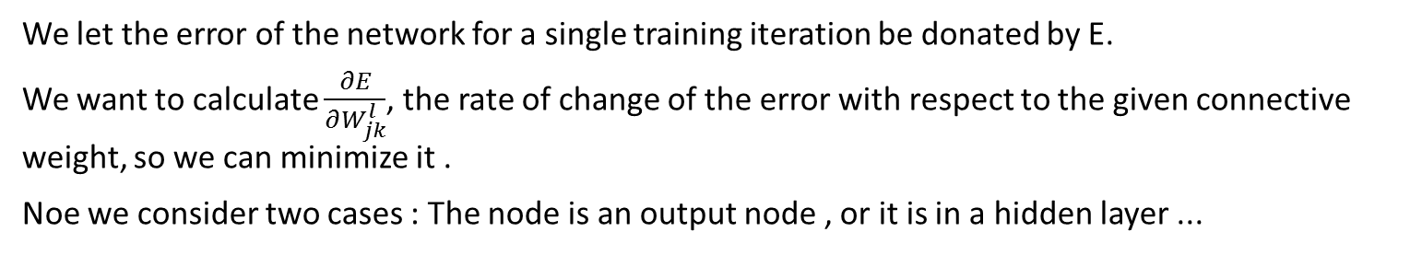

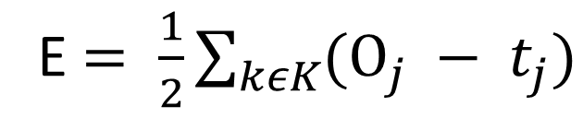
The error calculation
Given a set of training data points $t_{j}$and output layer output $Ο_{j}$
We can write the error as
E $= \frac{1}{2}\sum_{kεK}{(Ο_{j} − t_{j})}$
We let the error of the network for a single training iteration be donated by E.
We want to calculate $\frac{∂E}{∂W_{jk}^{l}}$, the rate of change of the error with respect to the given connective weight, so we can minimize it .
Noe we consider two cases : The node is an output node , or it is in a hidden layer ...

Slide 9





Output Layer Node
$$\frac{∂E}{∂W_{jk}^{l}}=\frac{∂}{∂W_{jk}^{l}}\frac{1}{2}\sum_{kεK}{{(Ο_{k} − t_{k})}^{2}}$$
$$=(Ο_{k} − t_{k})\frac{∂}{∂W_{jk}^{l}}Ο_{k}$$
$$=(Ο_{k} − t_{k})\frac{∂}{∂W_{jk}^{l}}σ(x_{k})$$
$$=(Ο_{k} − t_{k})σ(x_{k})(1−σ\left(x_{k}\right))\frac{∂}{∂W_{jk}^{l}}x_{k}$$
$$=(Ο_{k} − t_{k})σ(x_{k})(1−σ\left(x_{k}\right))Ο_{j}$$

